Slide 1
Smart Home Automation System Using Bluetooth and Wifi
PRESENTED BY
TEAM : ADMIN007 & INVINCIBLES
M.GIRIDHAR
K.HARISH REDDY
K.SNEHITH REDDY
M.R. KIRAN KUMAR
G.VIJAYA KUMAR
SRIHARSHA SALUVAJI

Slide 2
INTRODUCTION
To develop a Bluetooth and wi fi based home automation system with Arduino and Android device
Provides a simpler solution with Android technology
Remote operation is achieved by an smart phone with android OS based on touch interface

Slide 3
COMPONENTS & SOFTWARES
Nodemcu(esp8266)
Basic Shield
Bluetooth module
Arudino
Nodered
MIT App Inventor

Slide 4
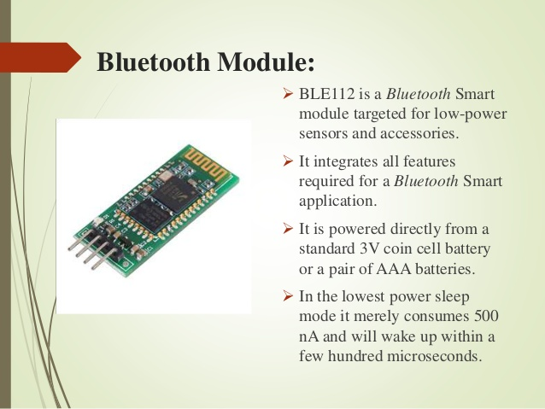

Slide 5
ADVANTAGES & DISADVANTAGES
WIRELESS CONTROL
MONITORING
STATUS CHECKING
MANUAL CONTROL
BLUEETOOTH RANGE
CONNECTIONS
APPLICATION SOFTWARE CONFIGRATION

Slide 6
FUTURE SCOPE
System can be used for building automation, industrial automation, hospital automation for patients and agricultural automation for farmers.
Different sensor can interfaced with the system such as motion sensor, light sensor, flame sensor, temperature sensor
Automation toggling of device based on certain situation can also be implemented Wi-fi and Ethernet based home automation systems can be developed.

Slide 7
CONCLUSION
Home automation market is very auspicious sector which is developing rapidly
Modeling and execution of home automation system using Bluetooth Module and GSM through android application
While using Bluetooth the motive of the system is to use mobile phone integral feature for automating the Home
The key advantage of system is if control circuit fails then manual switching option of traditional method is available.

